Slide 1
The Impact of Budgetary Reallocations on Education and Public Health Sectors
March 21, 2025
Ahmed Heri Firdaus
Esther Sri Astuti
Izzudin Al Farras
Mariska Ramadini
M. Rizal Taufikurahman
Sia Nawir
Yesi Hendriani Supartoyo

Slide 2
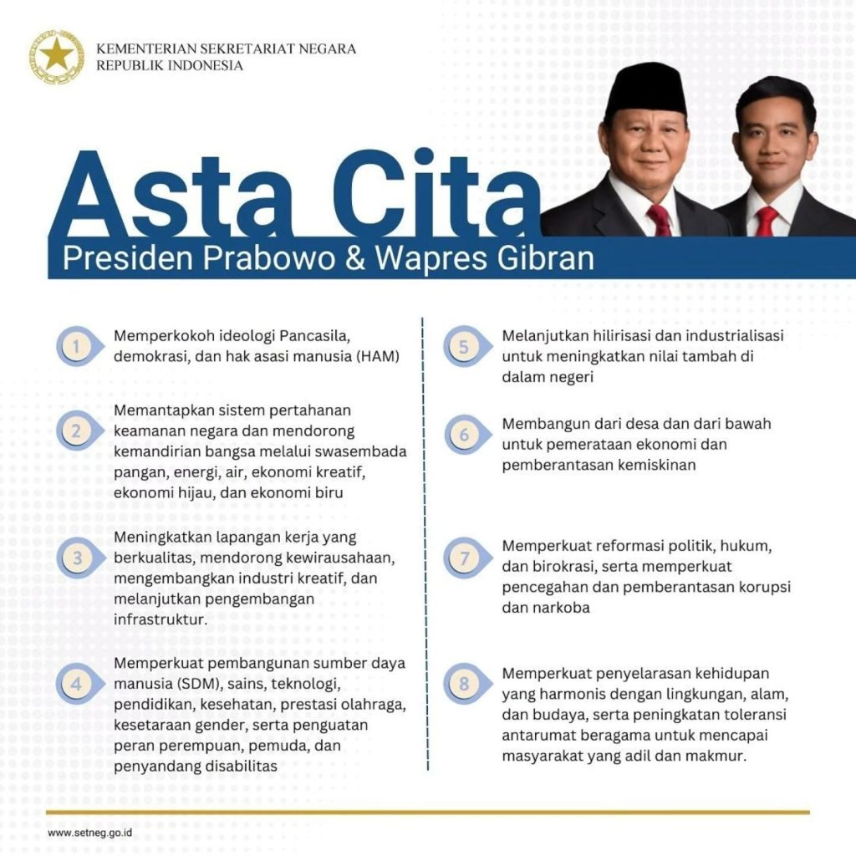
Background: The Importance of This Research
Research on education and public health budgets is crucial for Indonesia’s economic development, social stability, and global competitiveness.
The allocation of resources for education and healthcare is integral to Indonesia’s Vision 2045 (Asta Cita), with human capital investment playing a critical role in achieving economic transformation and sustainable development.
The presidential directive on budget efficiency directly affects funding for education and healthcare, influencing their ability to meet national goals and public service needs.
The policy and economic environment, including factors like macroeconomic stability and fiscal health, are vital in shaping the effectiveness of budgetary decisions for these sectors.

Slide 3
Research Questions
How does the budgetary allocation on education spending affect the economy?
In terms of labor supply and income
In terms of fiscal perspective
In terms of macro perspectives
How does the budgetary allocation on public health spending affect the economy?
In terms of labor supply and income
In terms of fiscal perspective
In terms of macro perspectives

Slide 4
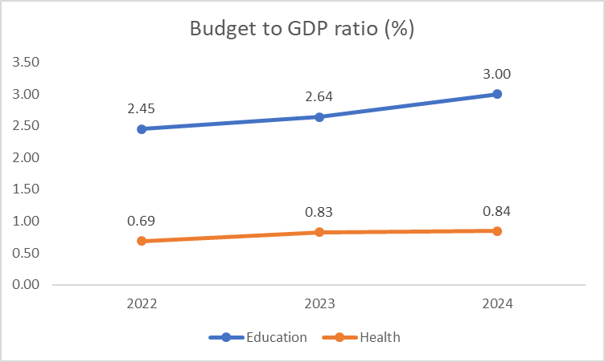
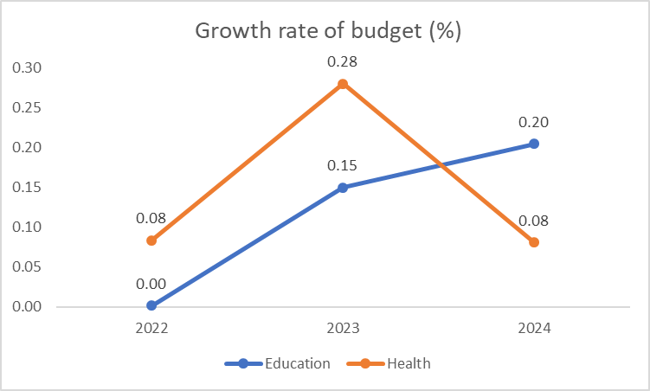
Historical Data on Budget Allocation
did you do any specific calibration?
was there any compelling data?
Source: Ministry of Finance (2025), Statistical Bureau (2024)
Over the past three years, the education budget has increased by an average of 0.12% annually, whereas the health budget has increased by an average of 0.15% annually.

Slide 5
Model Calibration & Assumptions
Education Spending Reform:
Increase in budgetary allocation on education spending by 0.5% (in term of GDP)
Public Health Spending Reform:
Increase in budgetary allocation on public health spending by 2.5% (in term of GDP)

Slide 6
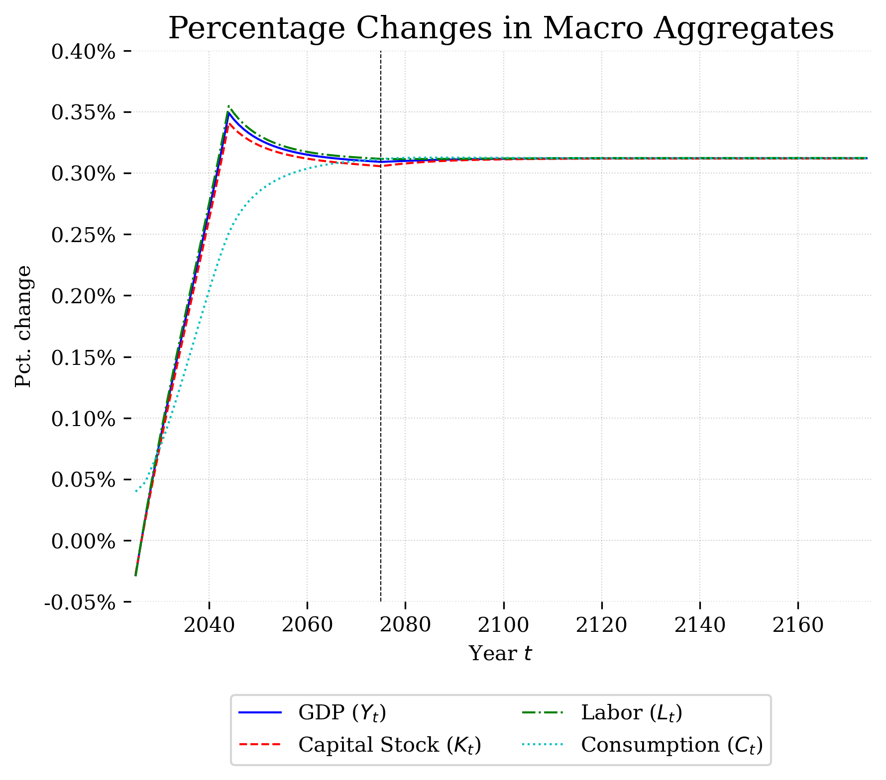
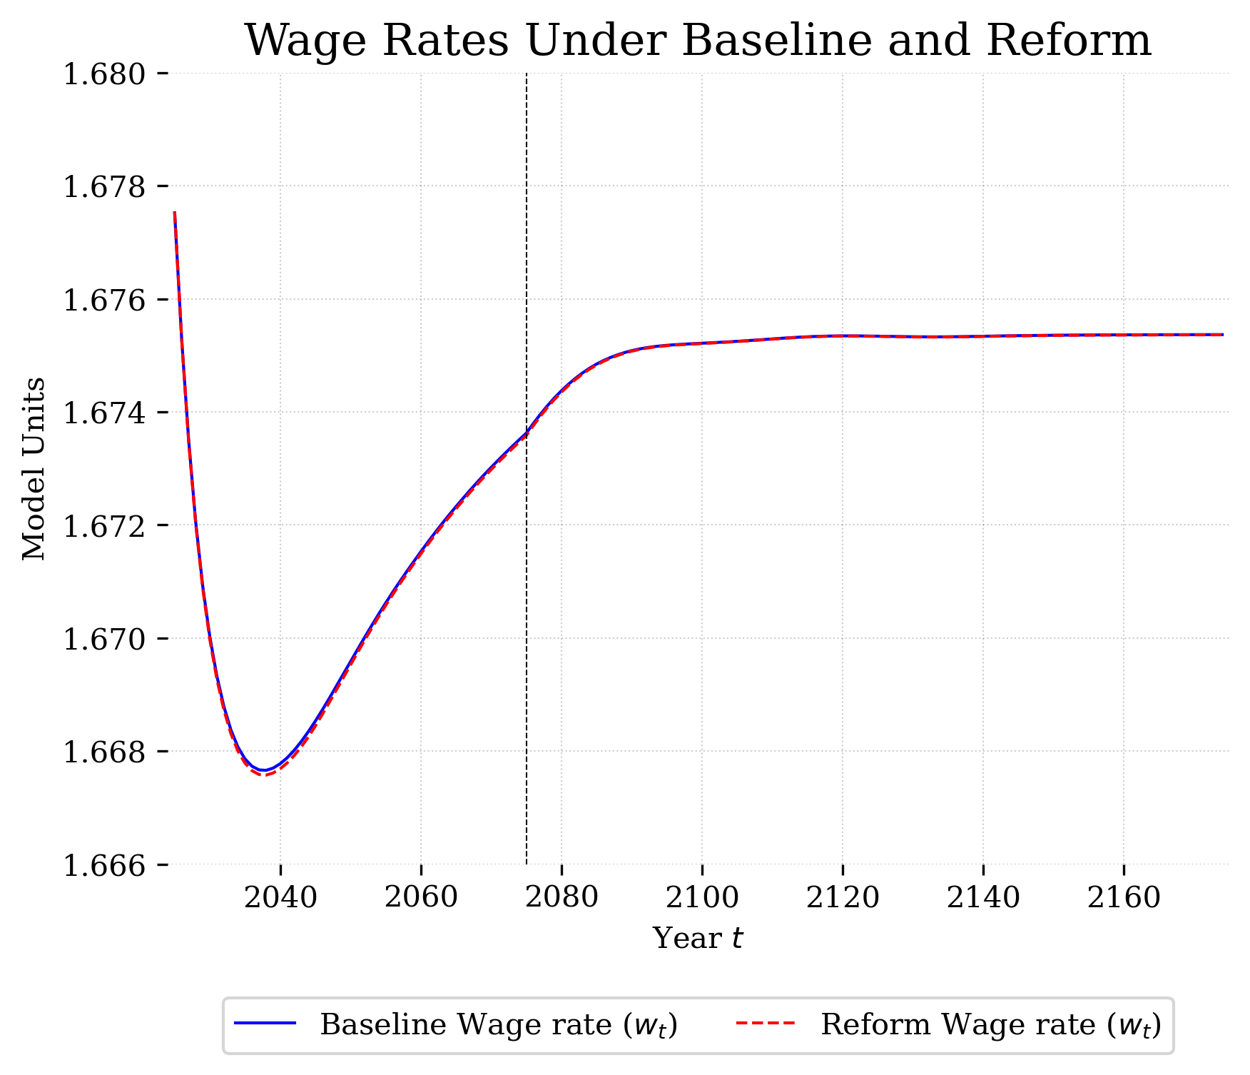
Education Spending – Macro Variables
Source: OG-IDN MODEL

Slide 7
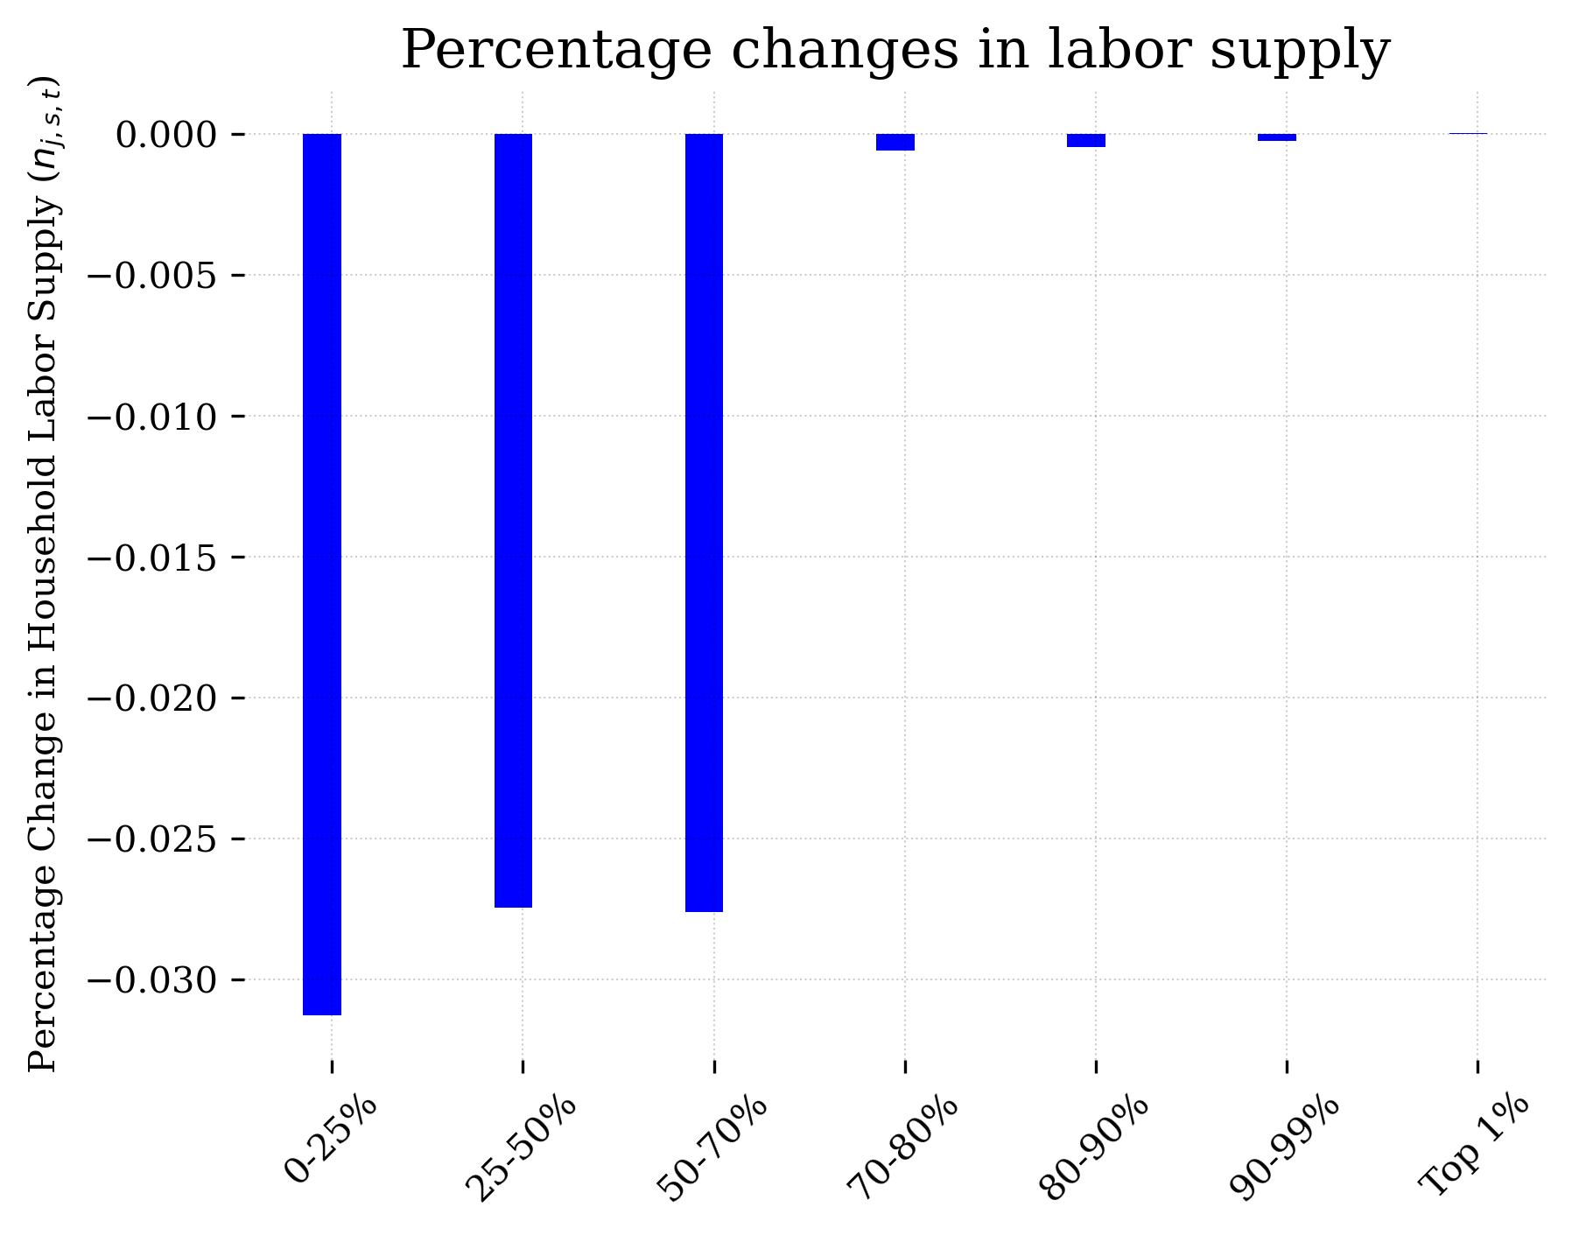
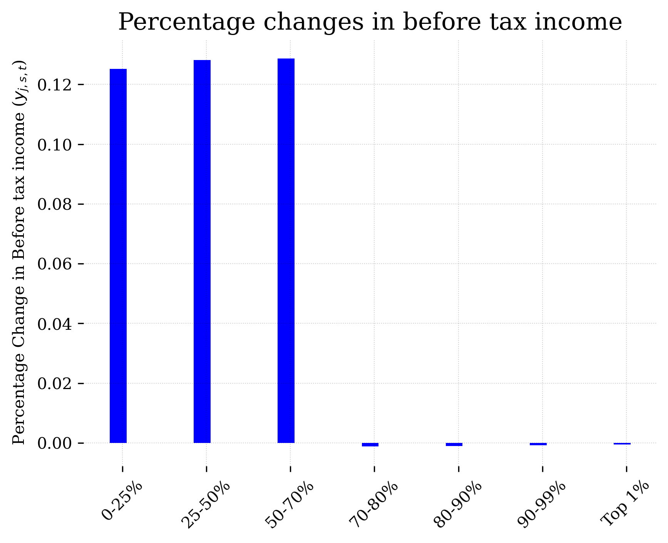
Education Spending - Impact on the Labor Supply
Source: OG-IDN MODEL

Slide 8
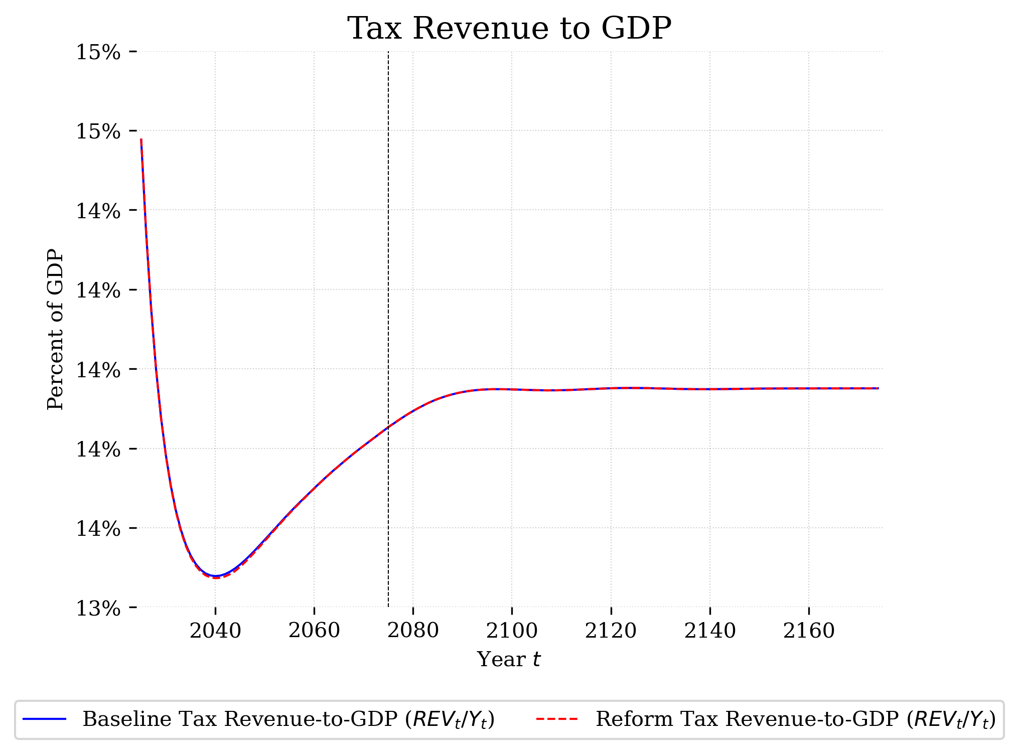
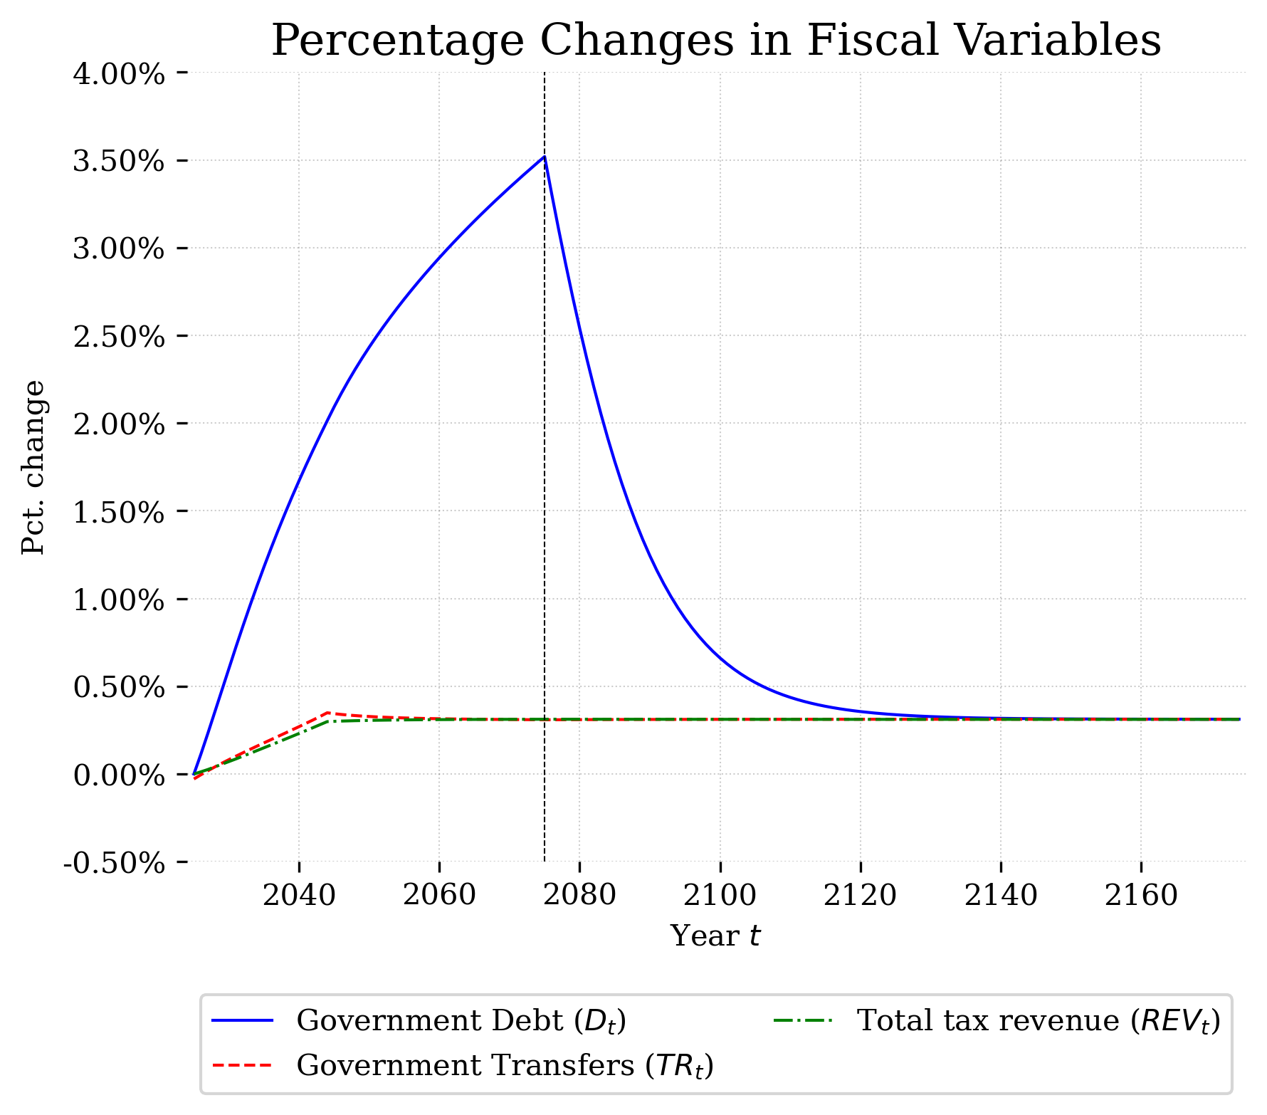
Education Spending – Fiscal Perspective
Source: OG-IDN MODEL

Slide 9
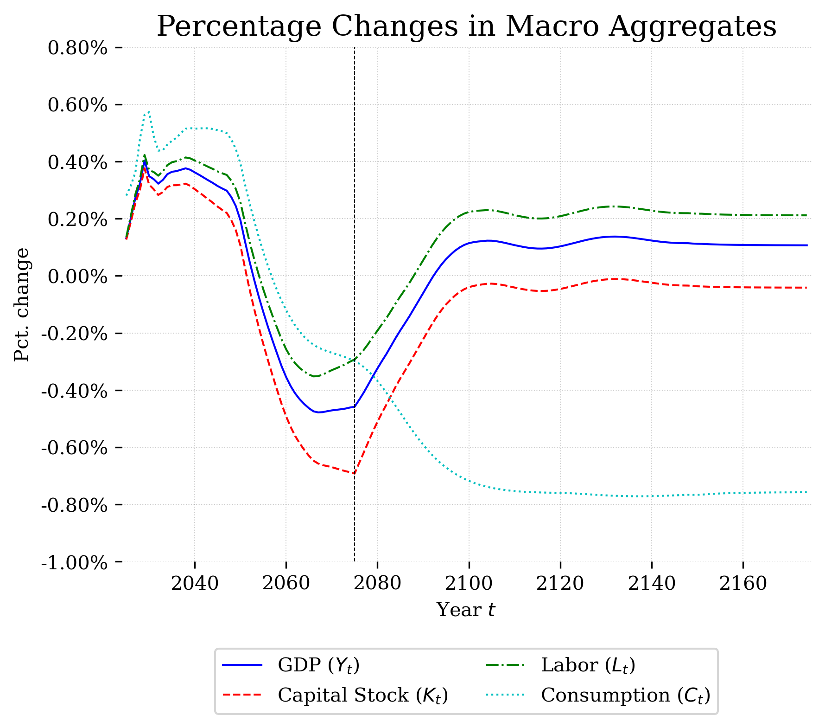
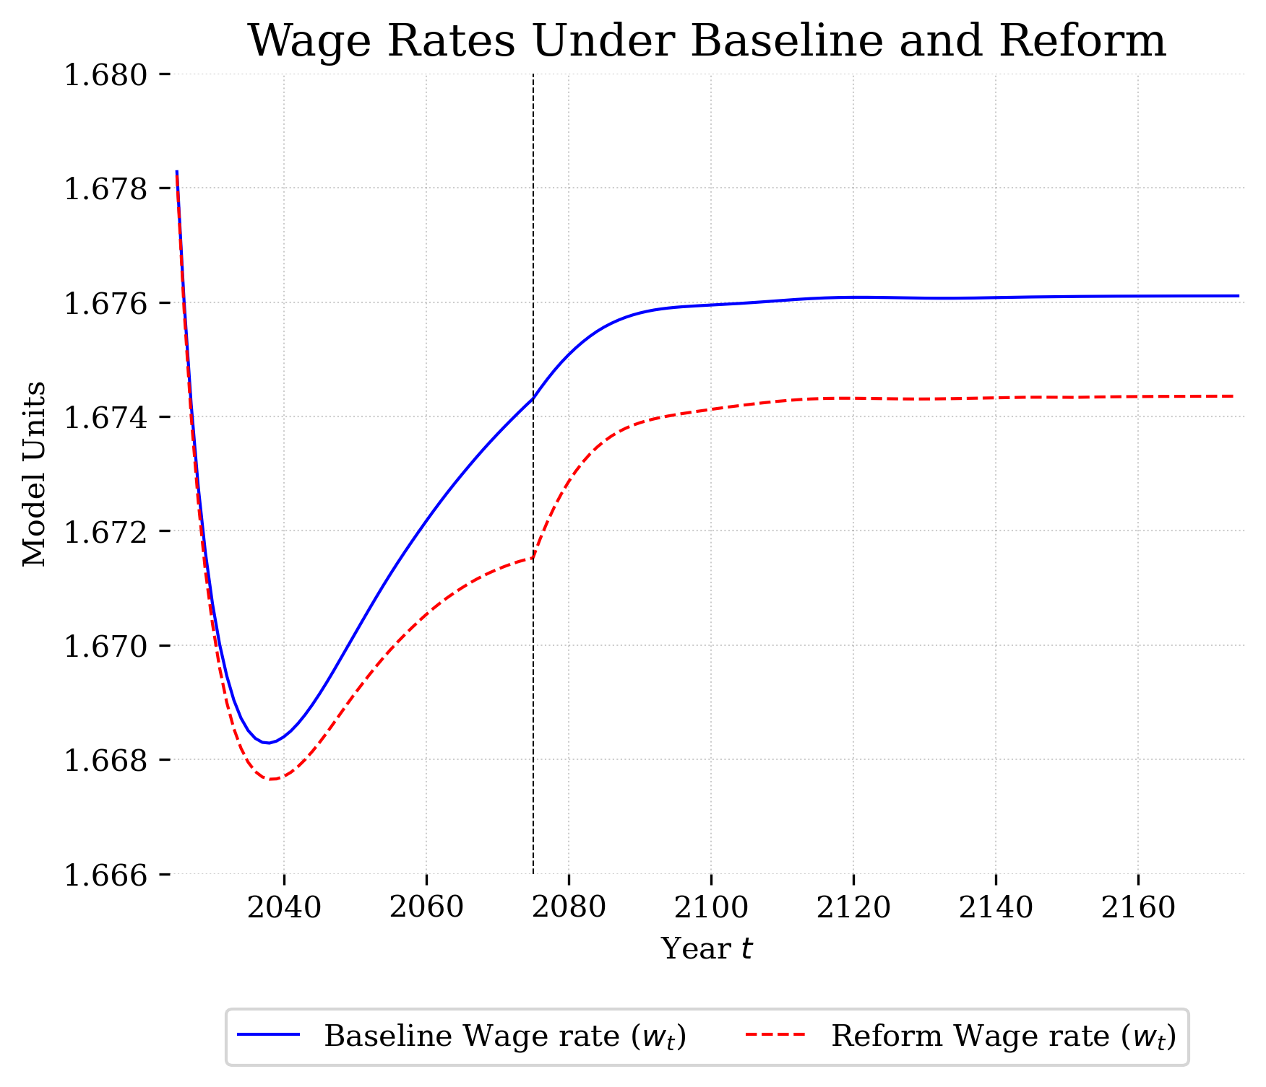
Public Spending – Macro Variables
Source: OG-IDN MODEL

Slide 10
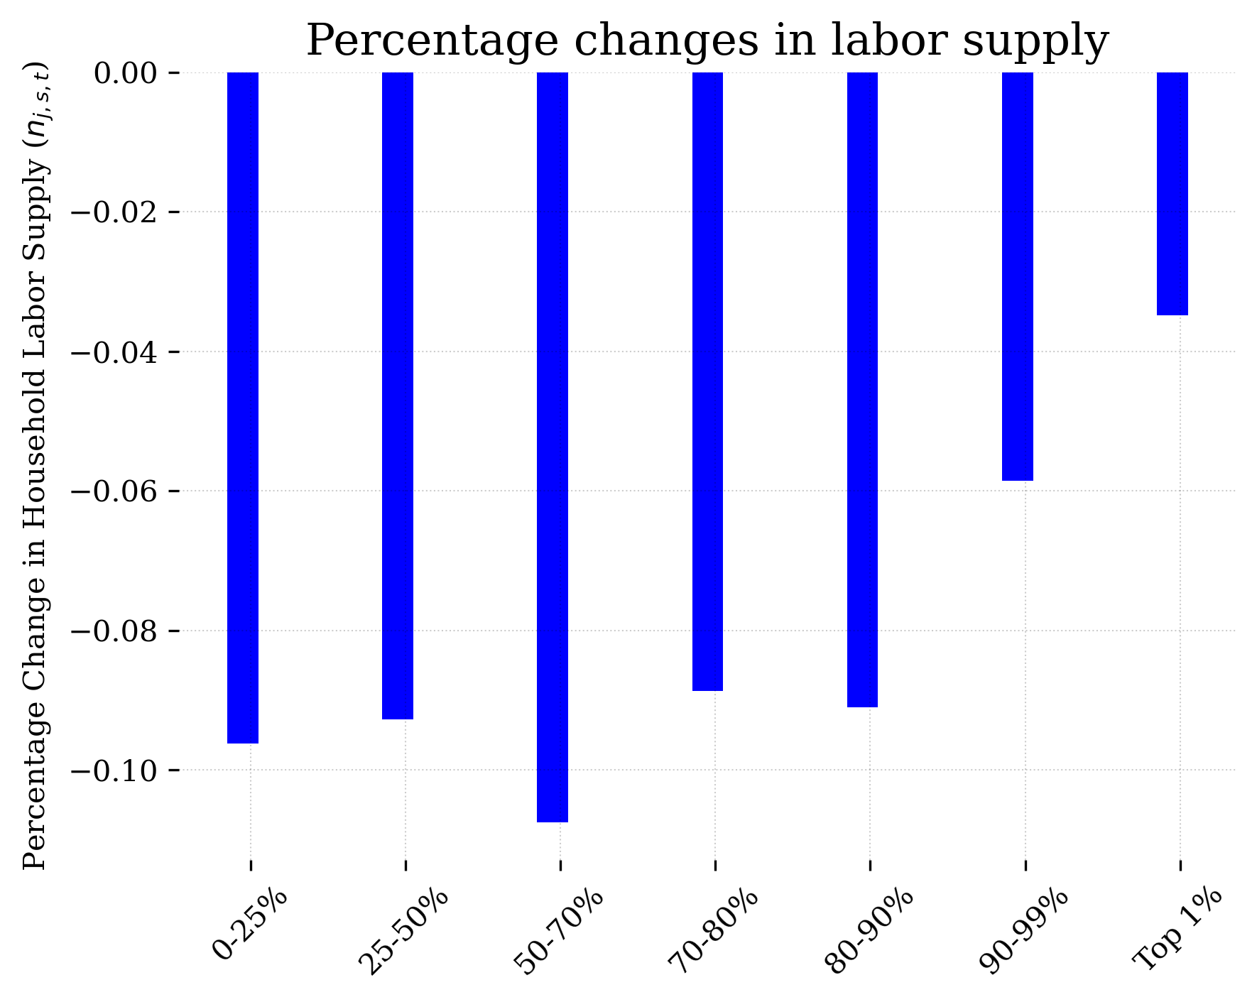
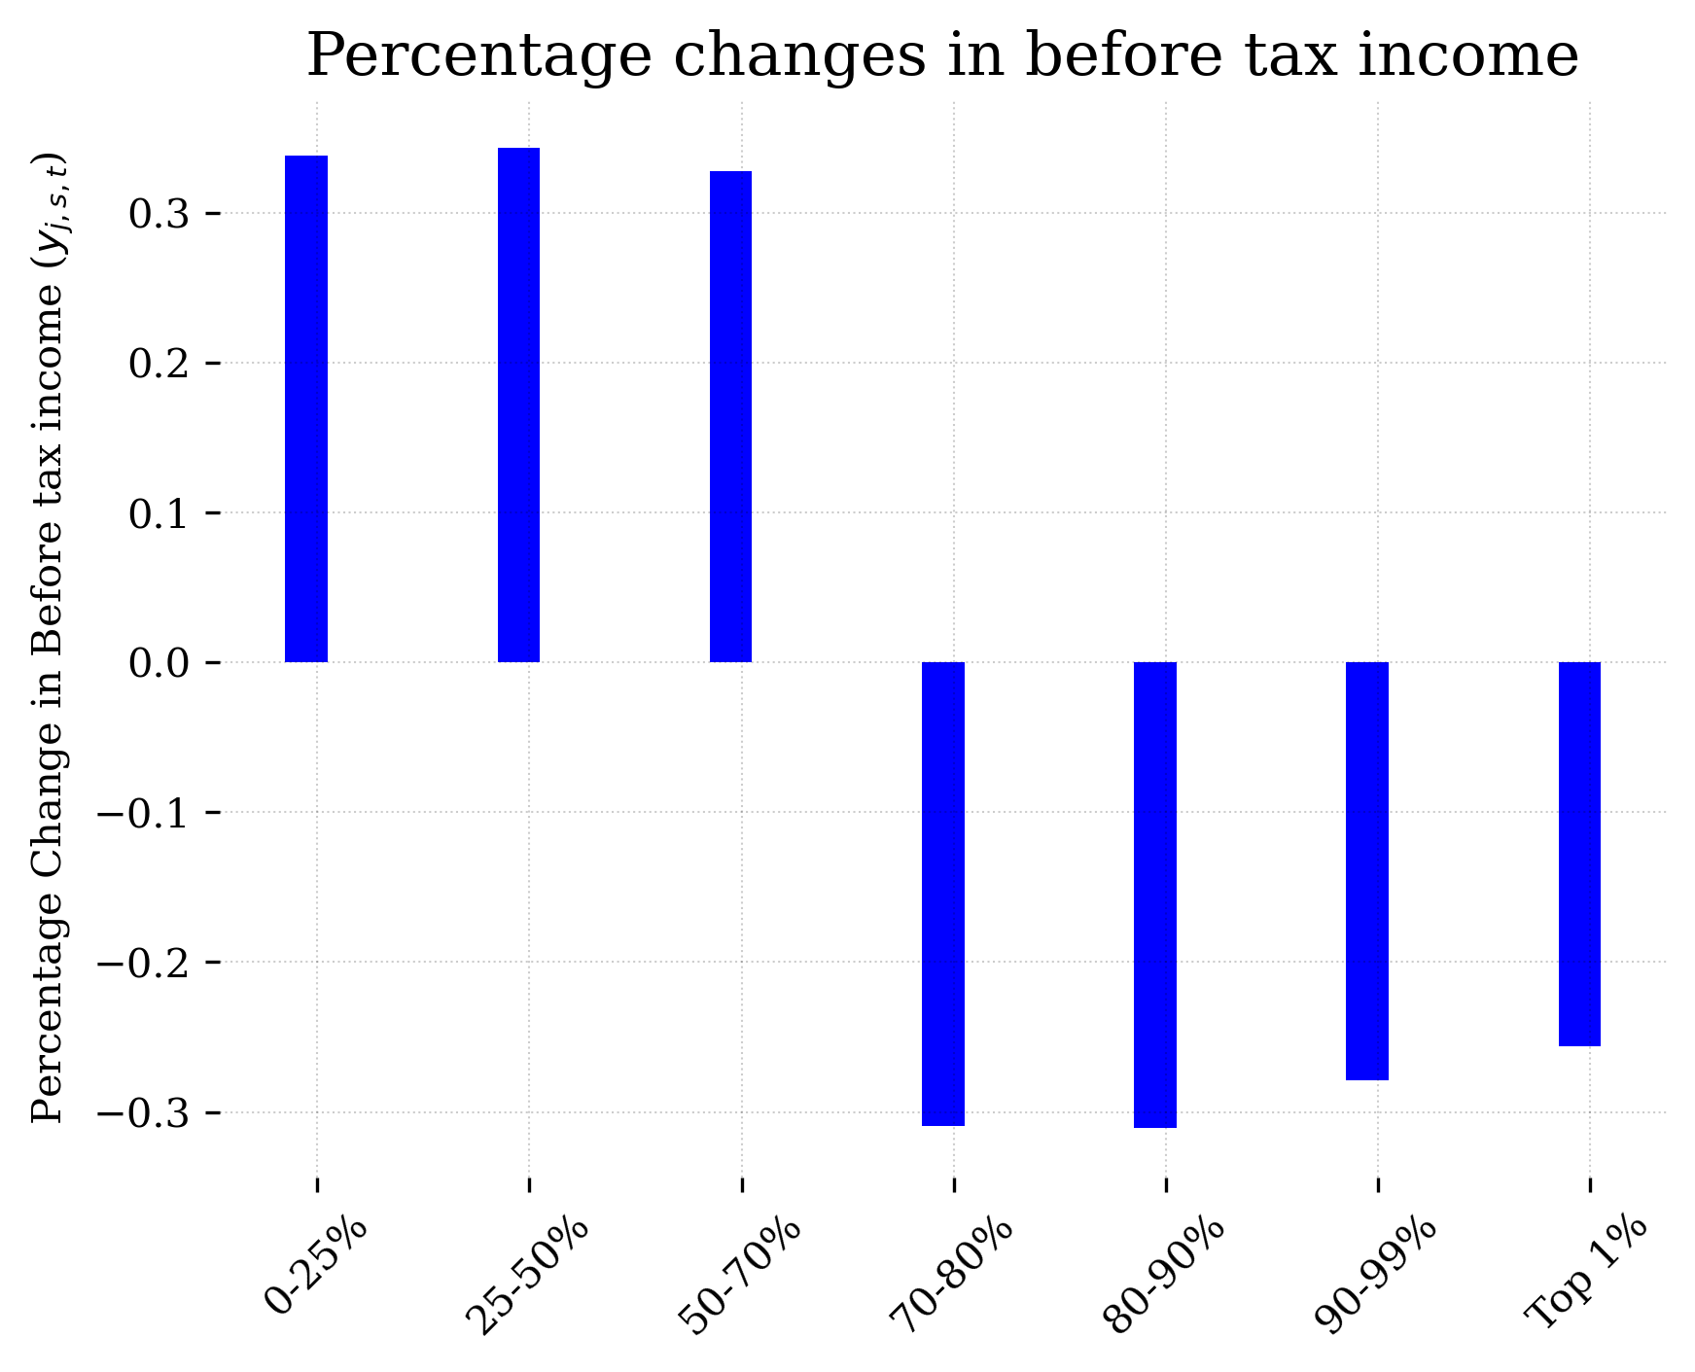
Public Health Spending - Impact on the Labor Supply
Source: OG-IDN MODEL

Slide 11
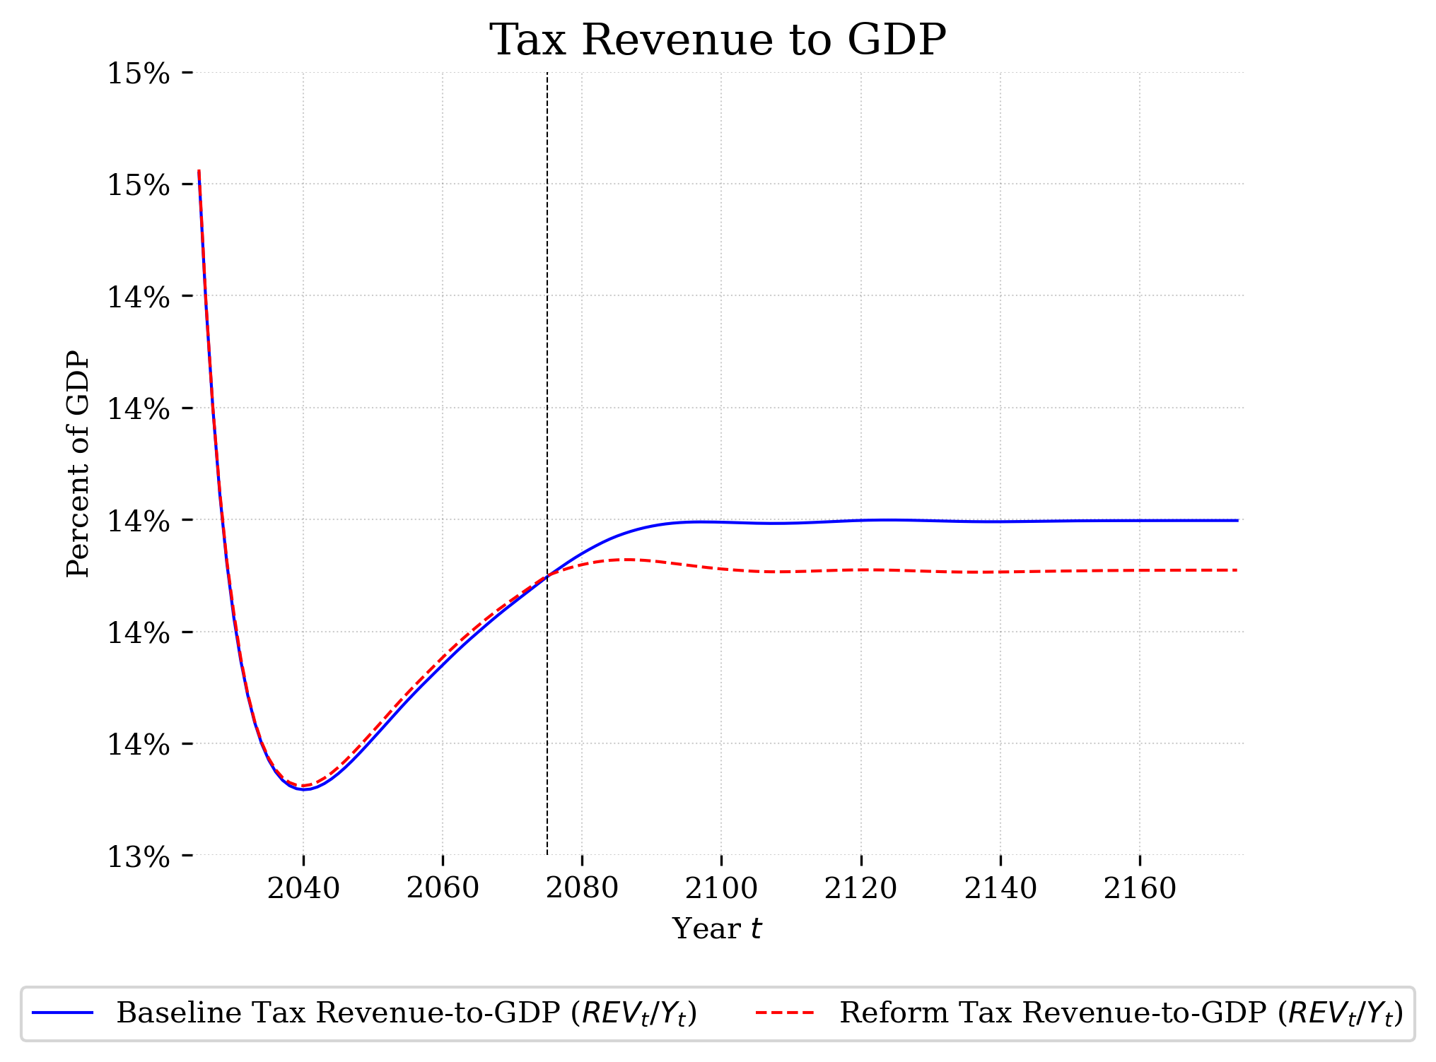
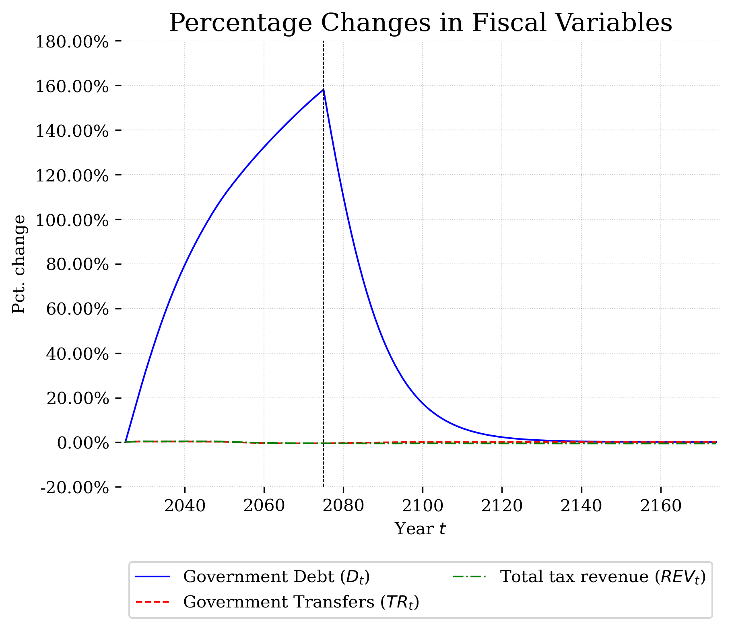
Public Health Spending – Fiscal Perspectives
Source: OG-IDN MODEL

Slide 12
Insights
Education drives economic development by improving human capital, increasing productivity, and supporting higher-value industries.
Health improvements contribute to economic growth by boosting productivity, life expectancy, and overall income levels, leading to sustainable long-term growth.

Slide 13
Future Research Questions for Public Policy
How much does the government have allocate its budget to spend on education and public health spending in order to :
Reach the steady state in certain time frame?
Achieve the target GDP growth rate?
Does the benefit outweigh the cost? (Income, household consumption etc.,)

